Slide 1

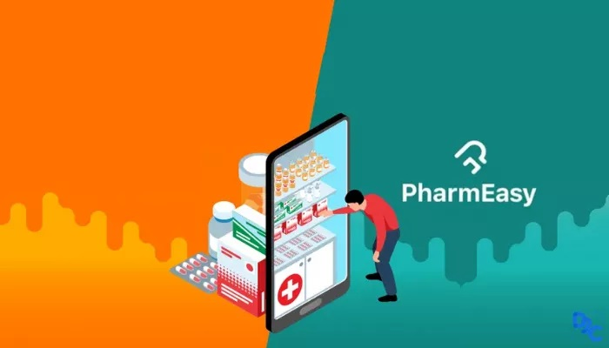
Increase Engagement and Monetization
Features for PharmEasy
‘PharmEasy, PharmEasy, Take it easy PharmEasy’
Virendra Kumar Verma
IIT Guwahati
Roll No. -190122057

Slide 2
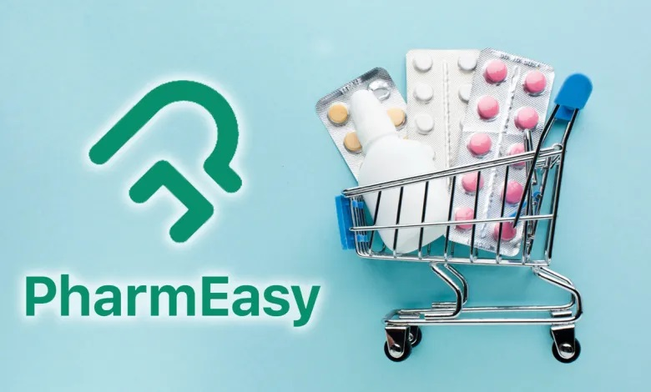
Overview
User Personas
Features
Prioritization
Success Metric
GTM
Goal -
Launch new features on PharmEasy to acquire new users and engage them on the platform and build trust among users by providing better facilities.
About PharmEasy
PharmEasy is one of India's top online pharmacy apps.
You can purchase medicines online & get it delivered to your home within 24-48 hours. Presently, PharmEasy widens its supplies to nearly 98% of the Indian pin codes.
PharmEasy has served over 50 lakh families for ordering medicines online & for booking diagnostic tests.
Revenue - Rs 2,360 cr
1 million patients for their pharmacy and diagnostics needs, conducts over 3 lakh consultations, and issues over 1 million digital prescriptions on a monthly basis

Slide 3




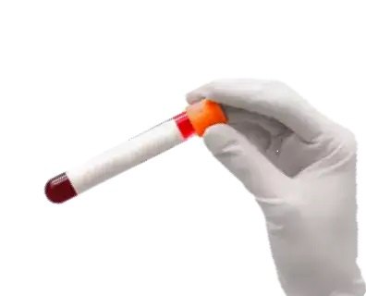





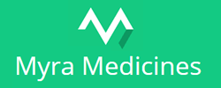
Overview
User Personas
Features
Prioritization
Success Metric
GTM
Services They Provide
Competitors
Skin Care
Health Care
Devices & Lab Tests
Baby & Mom Care
Home Care
Ayurvedic Care

Slide 4



Overview
User Personas
Features
Prioritization
Success Metric
GTM
Shrawan
Student
Delhi
22
Arpita
Businessman
Bangalore
34
Ramdhan
Retired teacher
Mumbai
60
Goal – Wants to recover his health by consuming better diet and fruits while having any particular disease.
Goal – Saving the time by taking a better online consultation.
Goal – To book online appointment for an in-person check-up.
Pain Points –
At his age he can’t explain properly what is he actually going through so want to go for in-person check-up.
Hard to find the doctor’s address and book an appointment.
Pain Points –
There is no option for doctor’s consultation before ordering the medicines (A proper online check-up)
She wants to go for the best doctor’s consultation.
Wants to go for video call consultation through the app.
Pain Points –
Don’t know what to eat while going through particular disease.
Its hard to find validated Information on google so, he cant rely on it.

Slide 5
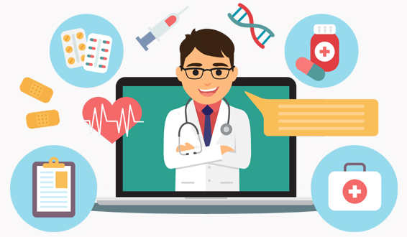
Overview
User Personas
Features
Prioritization
Success Metric
GTM
Feature 1 – Doctor Consultation
User can now take online consultation by the doctor who they wants to consult with on the app.
Adding Video call feature for consultation on app.
After done with Video call with Doctor, User can save the video in the app itself by categorized, which can help me later in case if he needs to be look into what the doctor told him about medicine, health-hygiene and proper diet etc.
Doctor consultation
Select the Type of Disease you have
Doctor details will be shown there with experience.
Fill the time when you want to see the Doctor
go for Video consult
done video consultation with doc
users can save the video consultation for future propose (here they will need a premium account).
choose the doctor you want to consult with

Slide 6
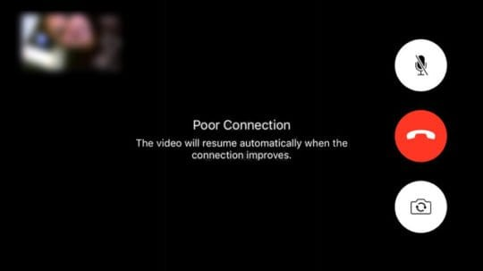
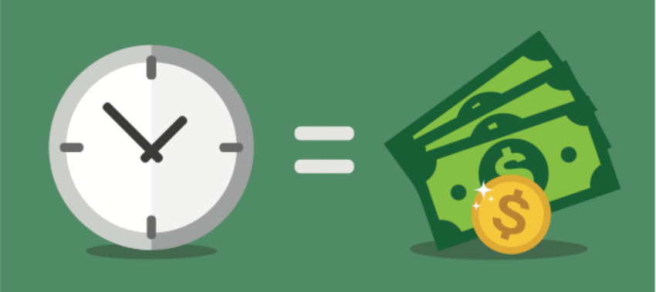

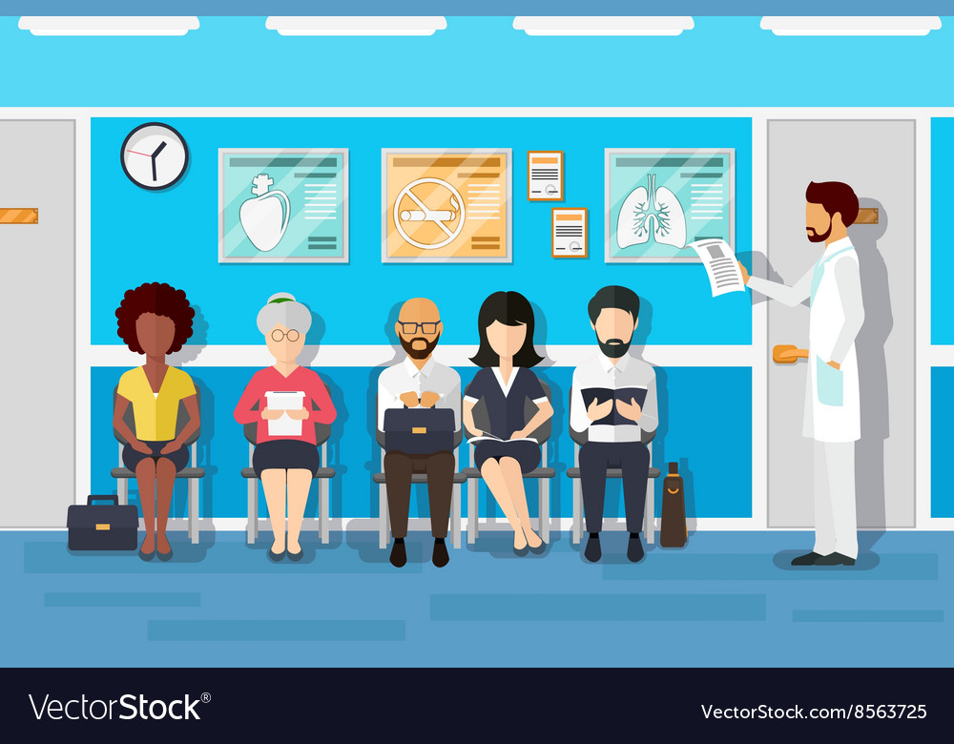
Overview
User Personas
Features
Prioritization
Success Metric
GTM
Extra - If they have some disease where they want a regular check-up, they can go for their particular doctor daily whenever they want (they will need a premium to access this)
Pros | Cons
User can save their time by taking online consultation. | Quality of Video consultation depends on a Wi-Fi connection or a good network.
No need to wait in long queue for check-up. | A physical check-up of body couldn’t possible which may lead to wrong prescription.

Slide 7
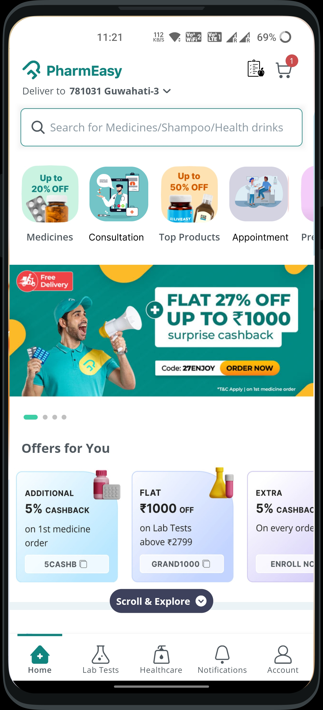
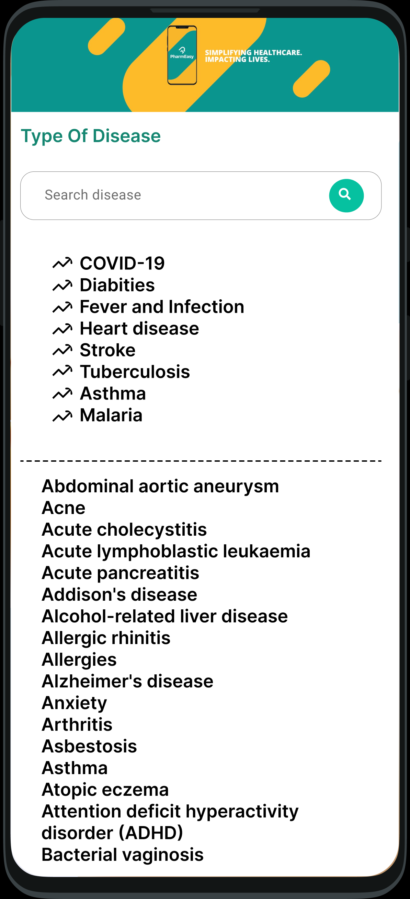
Overview
User Personas
Features
Prioritization
Success Metric
GTM
Feature 1 – Doctor Consultation (Wire-Frames)
select the type of disease you have
Based on that doctors detail will be filtered out and shown to you
Click on this button for an online Doctor consultation

Slide 8
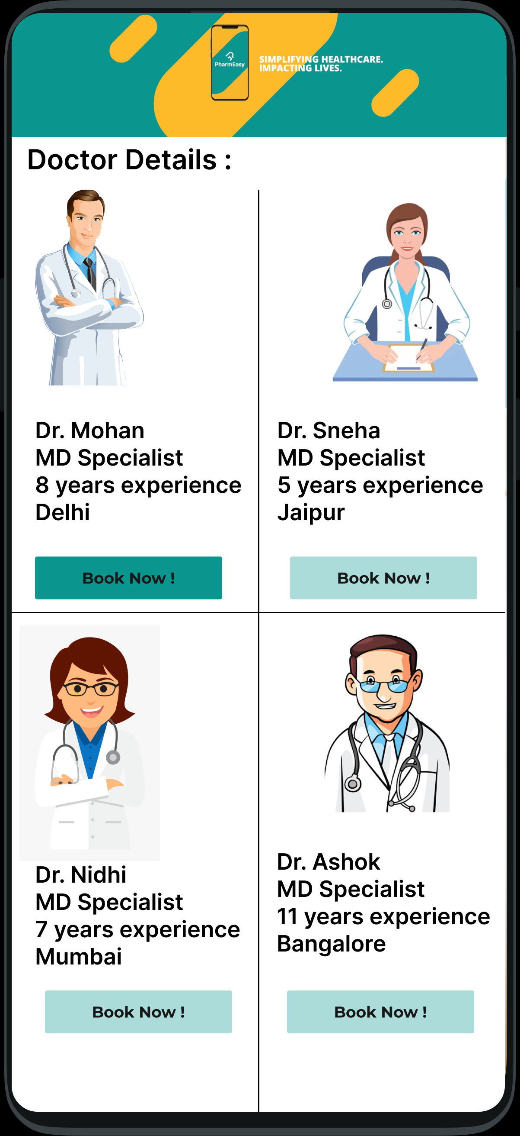
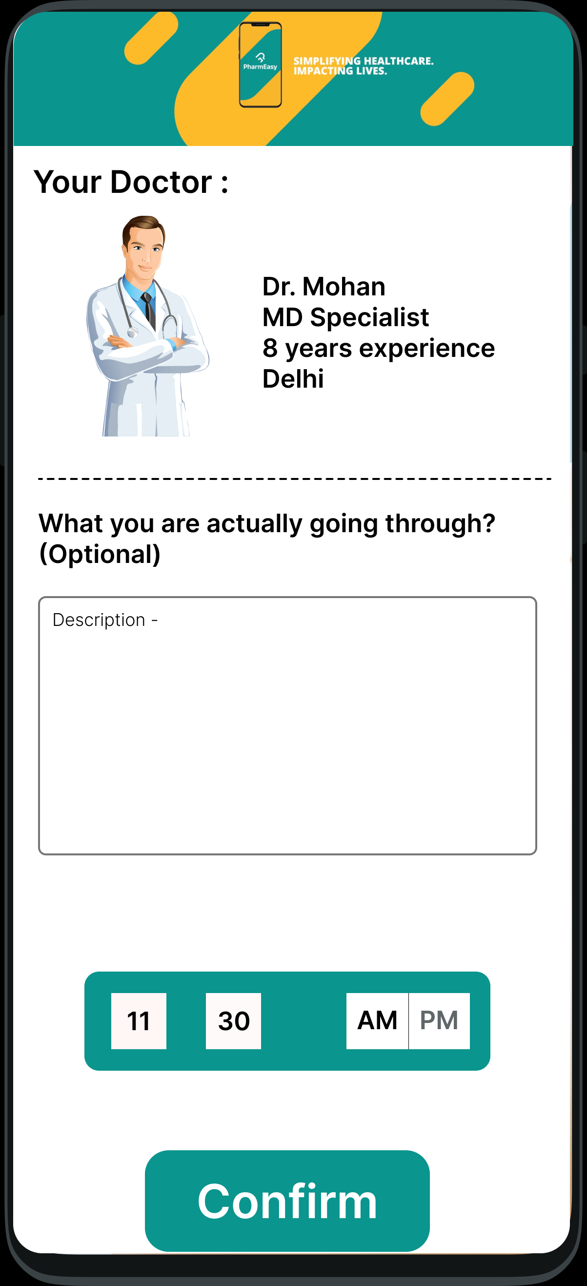
Overview
User Personas
Features
Prioritization
Success Metric
GTM
Feature 1 – Doctor Consultation (Wire-Frames)
If you are facing some other problems while having the disease just let your doctor know so he will consult you in best way possible
Go with the doctor you want to consult with
Fill the time you want to see the Doctor and Confirm your Online Consultation

Slide 9
Overview
User Personas
Features
Prioritization
Success Metric
GTM
Feature 2 – Health Diet Planner
People can search for proper health diet validated by specialist for particular disease they have.
After their Purchase we have the data about the medicines they bought. Basis on that we know what disease they have so we after their purchase we can pop a page of “what diet they should go for”.
We can partnership with Blinkit or BigBasket to sell the Fruits and Healthy Diet Foods to user by claiming that the products are well hygiene.
As those platforms don’t claim the health-hygiene products so it can raise a issue against this feature so, we can sell through our app just like we selling other product.

Slide 10

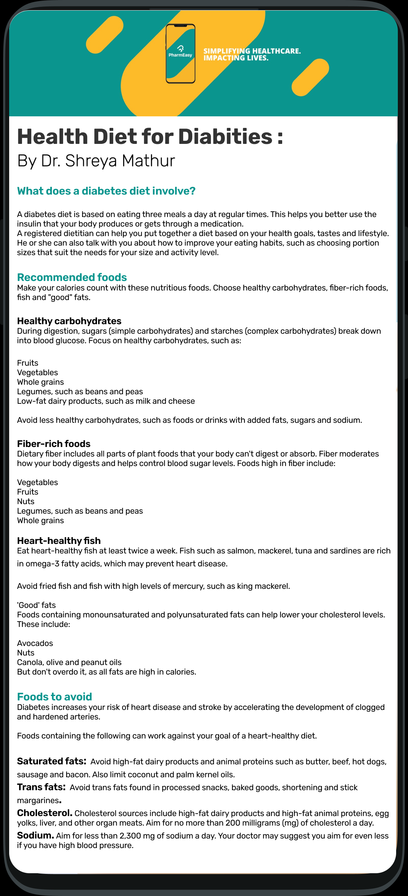
Overview
User Personas
Features
Prioritization
Success Metric
GTM
Feature 2 – Health Diet Planner (Wire-Frames)
Your health diet is ready
Select the disease you have

Slide 11
Overview
User Personas
Features
Prioritization
Success Metric
GTM
Feature 3 – Book Appointment
User can book an appointment to meet the doctor in-person.
Filled slots and yet to fill slots will be shown there.
Doctor’s address will be provided there, and they can directly search and connect the address to G-Map via app.
Time
Time slot available
Fill
Fill the time slot you want to book
Type
Type of Disease
Details
Doctor details will be shown there with experience
Choose
choose the doctor you want to consult with
Book
Book your in-person check-up appointment
Pros​ | Cons​
No rush for the offline appointment.​ ​ | ​ They do not find the specialist in their area for some disease.​ ​

Slide 12
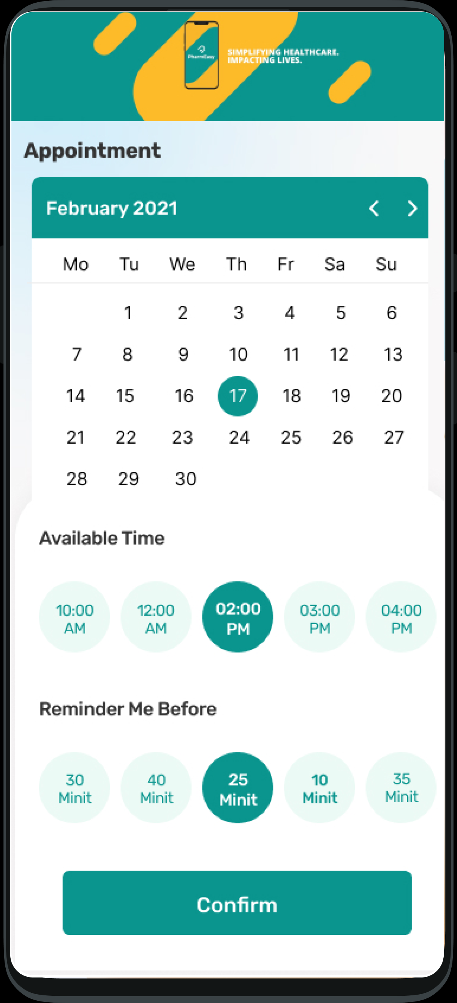
Overview
User Personas
Features
Prioritization
Success Metric
GTM
Feature 3 – Book Appointment (Wire-Frames)
Fill the Date and Time you want to see the Doctor
Click on this button to Book an offline appointment with Doctor

Slide 13
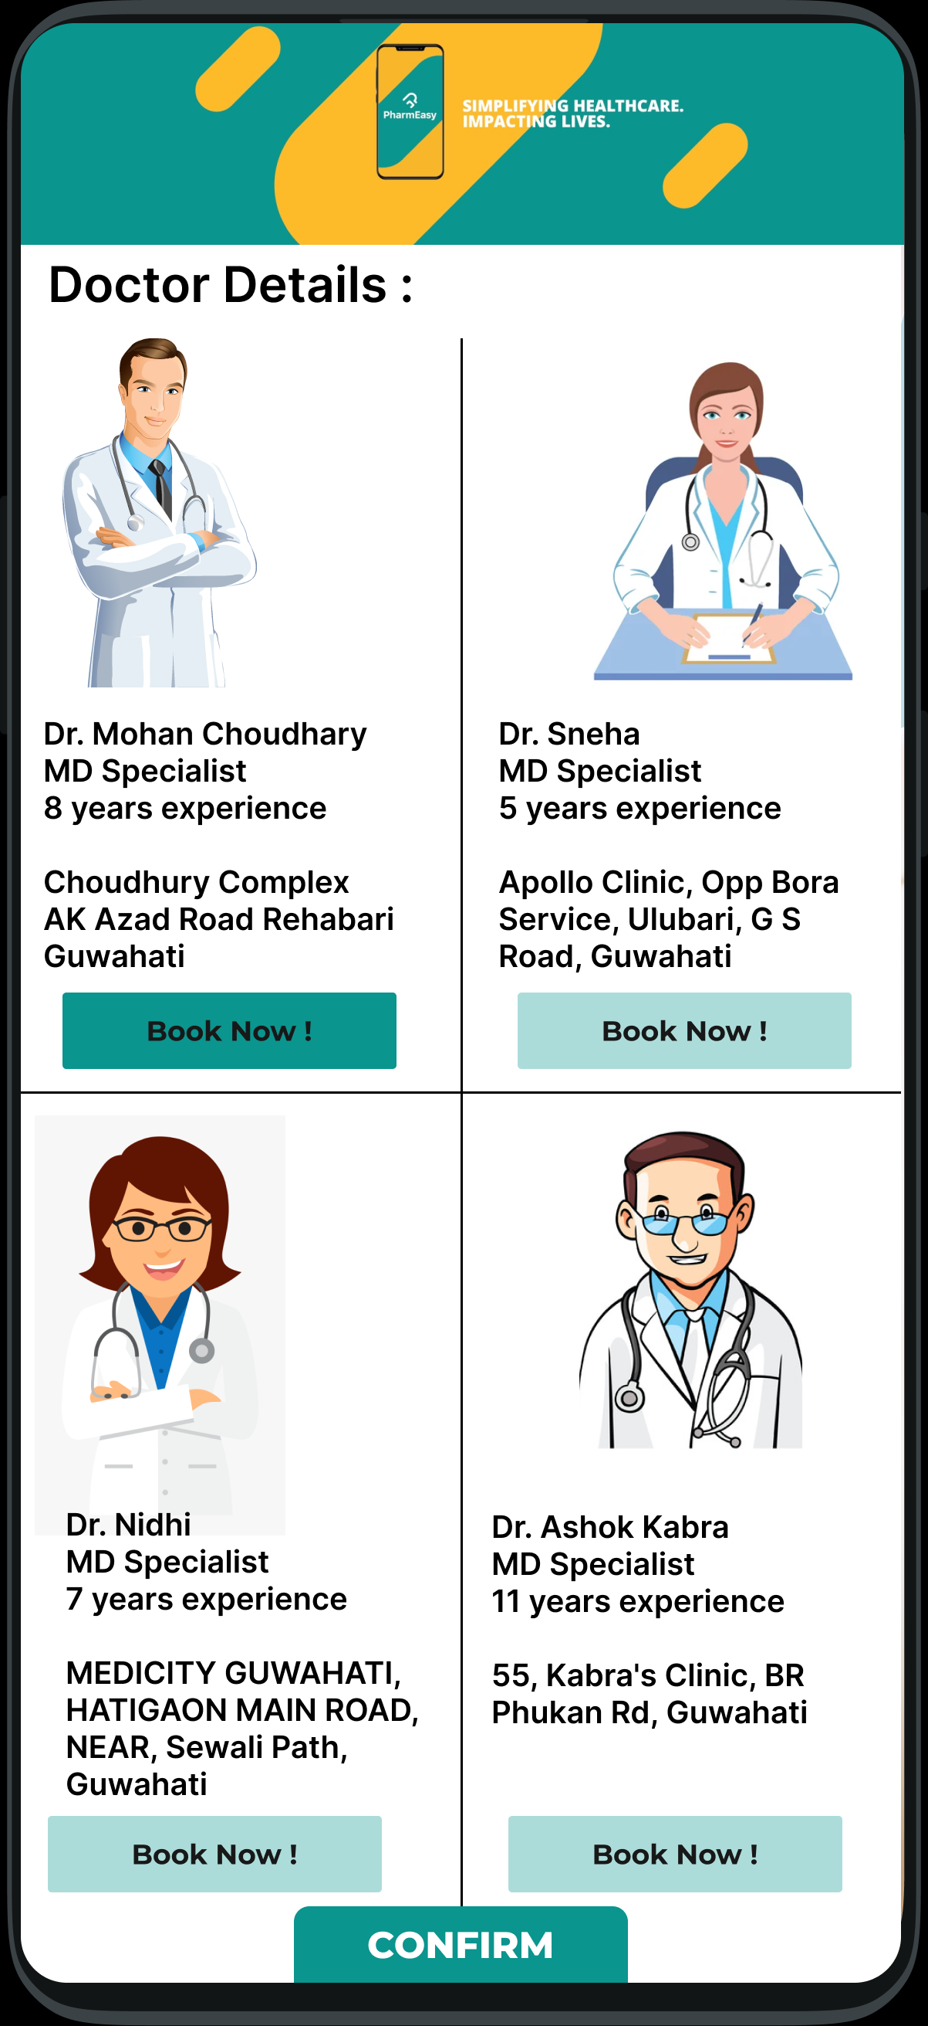
Overview
User Personas
Features
Prioritization
Success Metric
GTM
Feature 3 – Book Appointment (Wire-Frames)
Go with the doctor you want to consult with
select the type of disease you have Based
on that doctors detail will be filtered out and shown to you
Confirm your booking

Slide 14
Overview
User Personas
Features
Prioritization
Success Metric
GTM
RICE Metric
Feature | Reach (Out of 10) | Impact (Out of 10) | Confidence | Effort (Out of 10) | Score | Prioritization
Video Consultation | 9 | 9 | 90% | 9 | 810 | 1st
Health Diet Planner | 7 | 8 | 70% | 7 | 560 | 3rd
Book Appointment | 8 | 9 | 85% | 9 | 680 | 2nd

Slide 15
Overview
User Personas
Features
Prioritization
Success Metric
GTM
 | Happiness | Engagement | Adoption | Retention | Task
Goals | Customer finds the app useful and easy to use. | Customer finds app very useful and continues using it on a regular basis. | New customer see the value in the product or new feature and use it. | Customers keep using the app and remain as customers. | Customers complete their tasks easily and quickly.
Signals | Responding to surveys. Leaving 5-star ratings. Leaving positive feedback. | Returns on a daily basis. | Downloads and signs up for the app. Uses new features. | Continues to use the app after 3 months. Remains a customer after the 12 months. | Find actions and complete them quickly.
Metric | Net promoter scorer. Customer satisfaction rating. Number of 5-Star ratings. | Average number of sessions. Frequency of return. Number of actions in app. | Number of downloads. Number of registrations. Feature adoption. | Churn rate. Renewal rate. | Exit and bounce rate. Crash rate. Time in app.

Slide 16
Overview
User Personas
Features
Prioritization
Success Metric
GTM
Go-To-Market Strategy :
Market Research
Exploring all the features available on PharmEasy app. Understanding user pain points, preferences, and behavior. Conducting surveys and personal interviews along with Competitor analysis.
Feature development
Design and Technical development of the features like addition of Doctor Consultation, Health Diet etc. Feature development will be based on user stories.
Beta Launch
Developed Beta version of the features which will be released to a small sample of user stories collect initial performance data and user feedback ensuring remarkable Health journey.
Feedback
Based on the feedback collected beta version will be improved and final version of the features will be developed for the final release.
Final Release
Release of final version of all the features. Improvements will be advertised and communicated to users through notifications and app update information.

Slide 17
Thank You

